Slide 1


Android
Beautiful-Family

Slide 2
Team member：
白亚楠（12301088）
王 畅（12301106）
姚 杰（12301111）

Slide 3
Agenda
Purpose
Audience
User Scenarios&Cases
Design
Demo
Future Development
Notes:
下面我将从以下几个方面介绍我们的成绩管理系统：

Slide 4

Purpose
What time is better for sports?
How to cook XXX?
Which market is cheaper?
What’s better for Spring?
04

Slide 5
Purpose
Medical
Health
Cook
Sales
Fitment
Fransnana
Second-hand
04

Slide 6
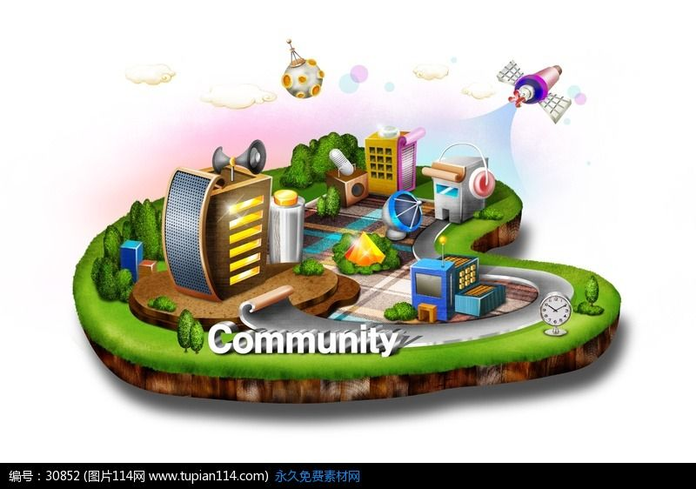
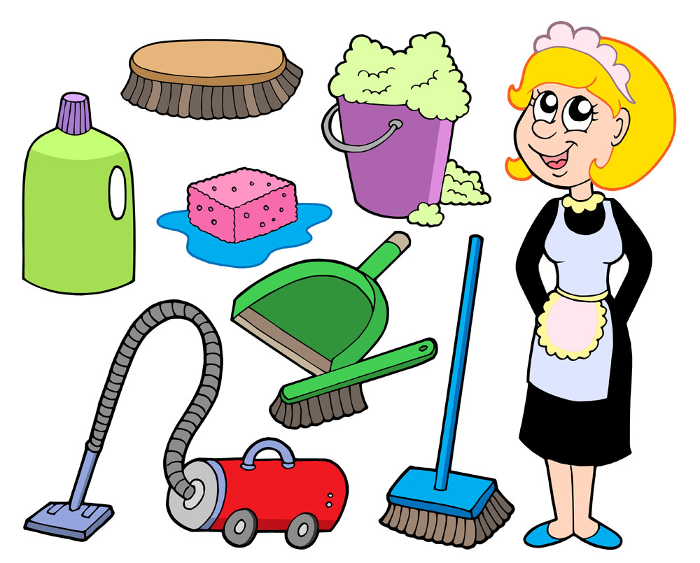
Audience
05
Notes:
1、People who support the family or look after the family. Beacause they are the person who need to deal with the problem of faimly. So they need these information to help them. 2、People who manage the community. Beacause they need the state of people who lived in their community. So they need our app to collect the information as well as publish information.

Slide 7
User Scenarios
I am a housekeeper, today I want to cook a delicious food. But I don't know how to do.
I am a neighborhood committee, I want to know the state of our people in community.
06

Slide 8
Use Case
Go to the news list
select a single building in the map which symbolizes the item
Viewing the news
when the user click one of theme of news. The app will go to the page showing the news today
Viewing the sharing
When the user click the sharing button. The app will show the sharing of friends
Comment sharing
When the user click the comment button, the app will show the sharing at the top of the page
07
Notes:
在第一部分，我们将原有的需求分析进一步进行了验证，通过了四个步骤，分别是

Slide 9
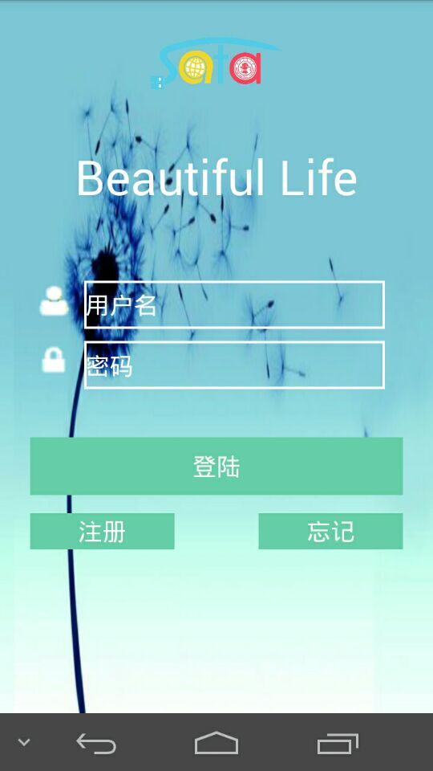
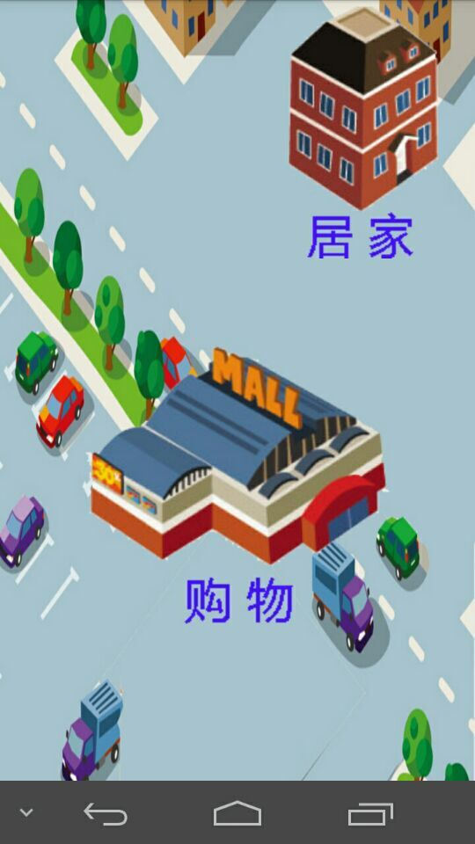
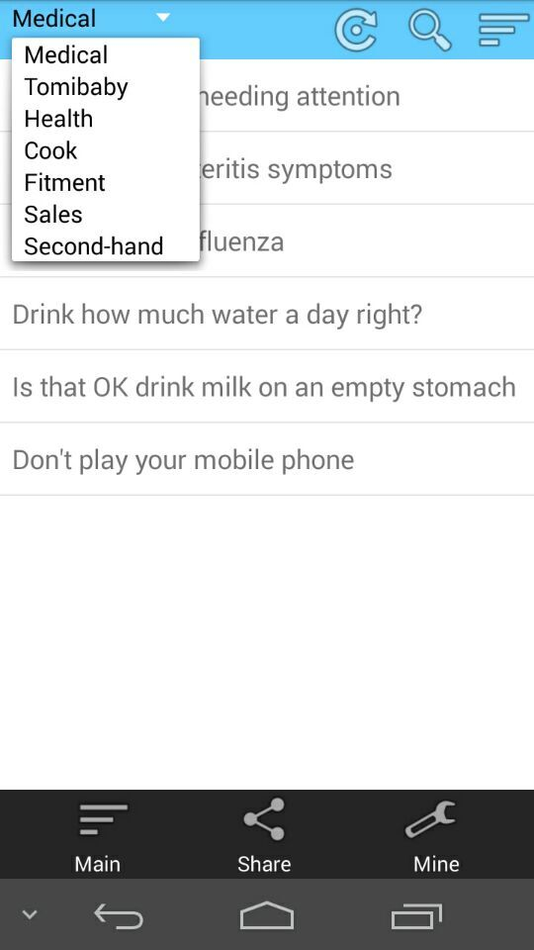

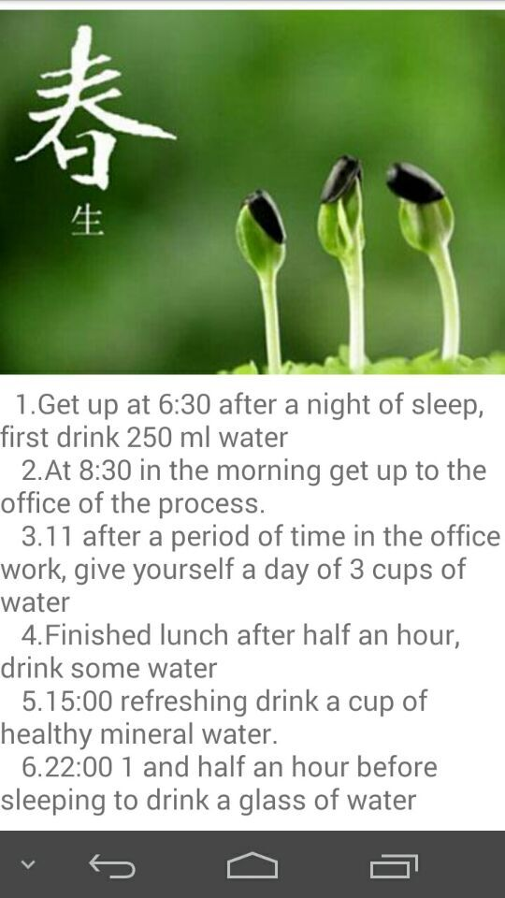
Design
08
Notes:
两个测试是不一样的。

Slide 10
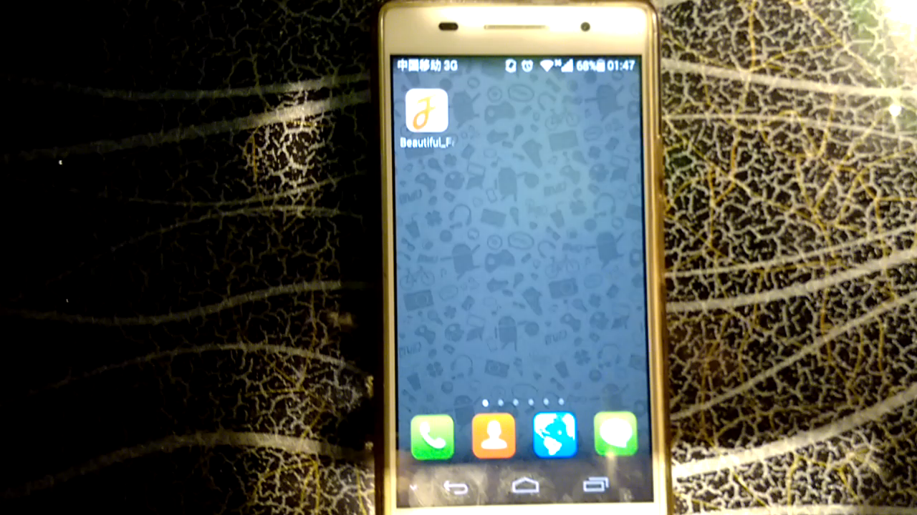
Demo
09
Notes:
除了以上的这三项之外呢，还有内里的材料，比如说芯片、集成电路板、镜头等等，这些我们都不自己生产，因为我们是一个软件公司而不是一个硬件公司，现在硬件的发展已经十分的发达，对于我们所需求的这些东西呢，现在市面上的硬件已经基本能够满足我们的要求。 当然在定下我们的原材料之后，就可以开始生产了，以下的两个方面

Slide 11
Future Development
Design the database and connect with database
Implement the left use case
Cooperate with companies related to daily life to provide useful and cheap goods for users.
Adding neighborhood committee role
Promoting our APP in popular social circle..
10

Slide 12
Thanks

